Slide 1
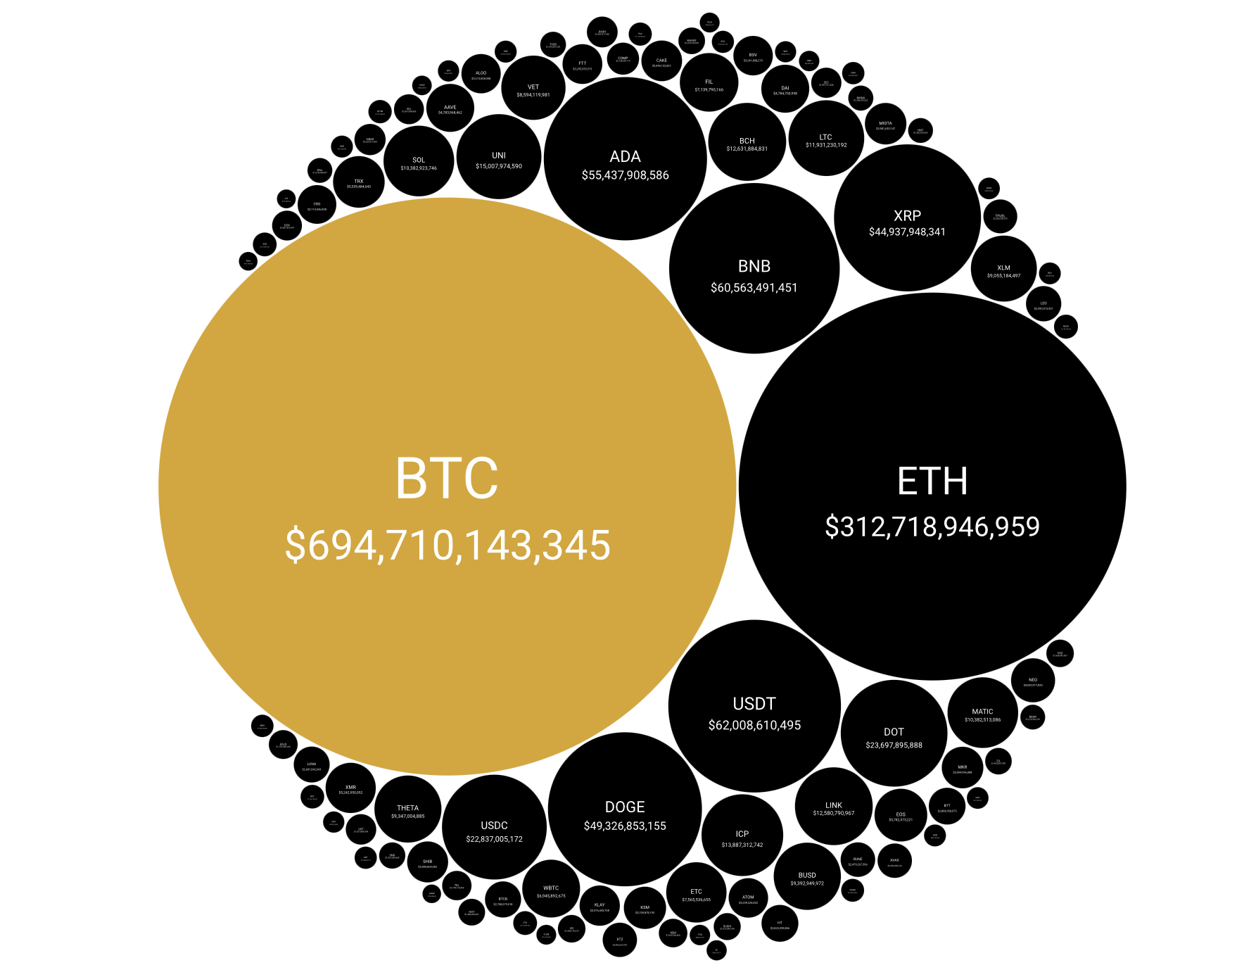

Crypto Currency Dashboard
By Nieveathan Shan, Jo Alva, Iana Pirogan, Miller Tamunosaki, Kaiser

Slide 2

Our API
Crypto Market Top 100 Currencies
Rich Data: The API provides comprehensive data on various cryptocurrencies, including their market cap, current price, trading volume, and more. This richness in data allows for diverse visualization opportunities, from simple price charts to comparative analyses of market capitalization.
Currency Conversion: no currency conversion which is useful for standardizing the data and comparing different cryptocurrencies on a common scale for visualization purposes.
Consistent and Reliable: CoinGecko is a well-established platform known for its reliability in providing cryptocurrency data. Using their API ensures access to up-to-date and accurate information, crucial for meaningful visual representations.

Slide 3
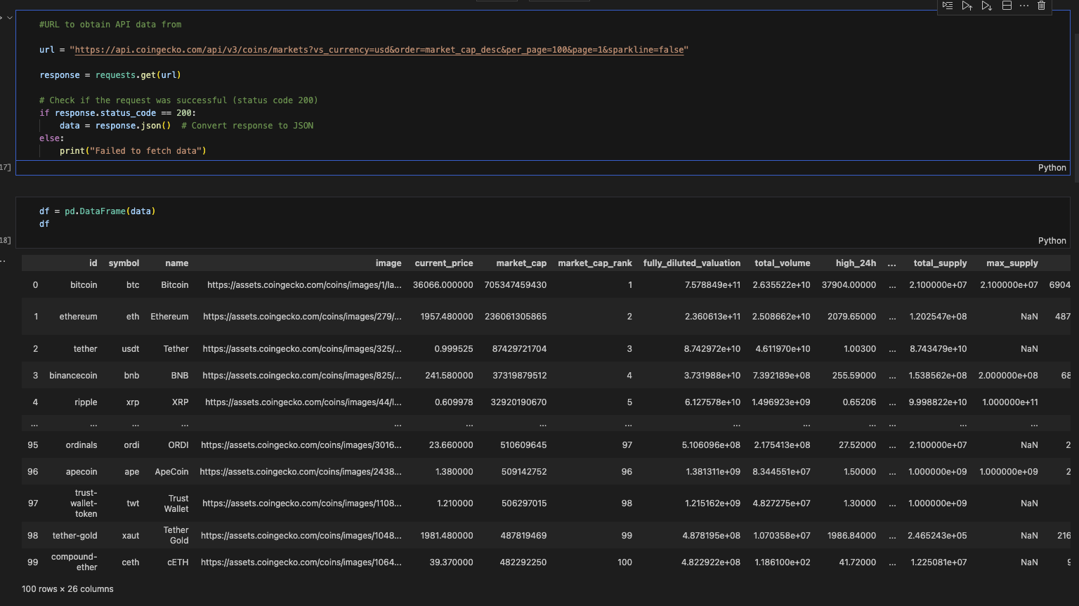
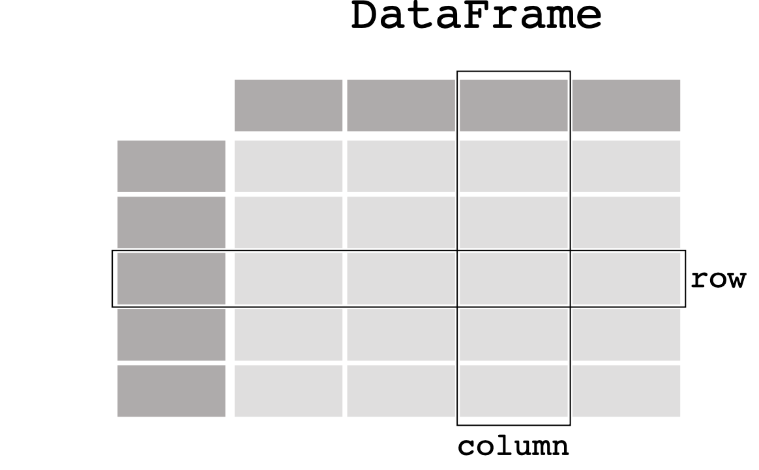

Extracting the DATA
We first pulled our API into a Jupyter notebook file and then cleaned it to provide the appropriate data we required.

Slide 4
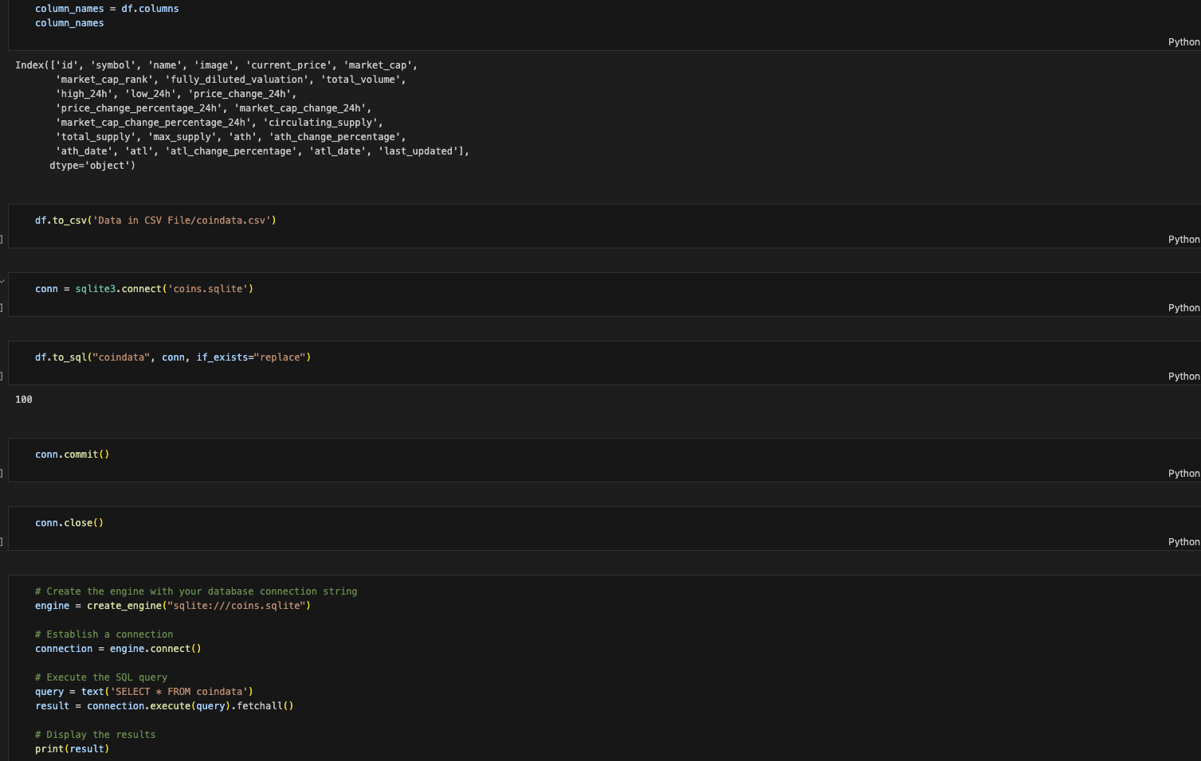

Creating our SQLite database
With the cleaned DataFrame, we checked the data was correct in Jupyter notebook, and then exported the data to a SQLite database.

Slide 5
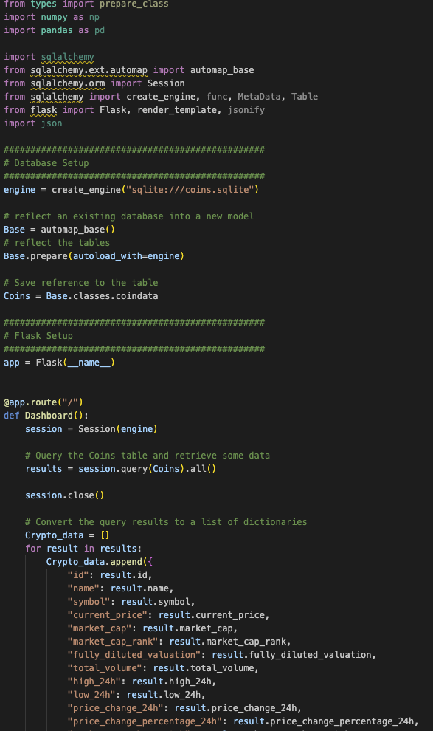

Flask
We then set up a Flask web application that interacts with the SQLite database containing the cryptocurrency data.
Imports: The code imports necessary libraries such as numpy, pandas, sqlalchemy, and Flask modules for handling data, database interaction, and web services.
Database Setup: It configures a connection to an SQLite database named "coins.sqlite" using SQLAlchemy. It reflects the existing database schema into a declarative base and prepares it for use within the application.
Flask Setup: It initializes a Flask application.
Route Setup: Defines a route ("/") that corresponds to a function named Dashboard(). This function interacts with the database and retrieves data from the Coins table.
Database Query: Inside the Dashboard() function, it initiates a session to the database engine. It performs a query to retrieve data from the Coins table and stores the results in a variable named results. Then it converts these results into a list of dictionaries named Crypto_data, mapping each column in the database to a key-value pair in the dictionary.

Slide 6
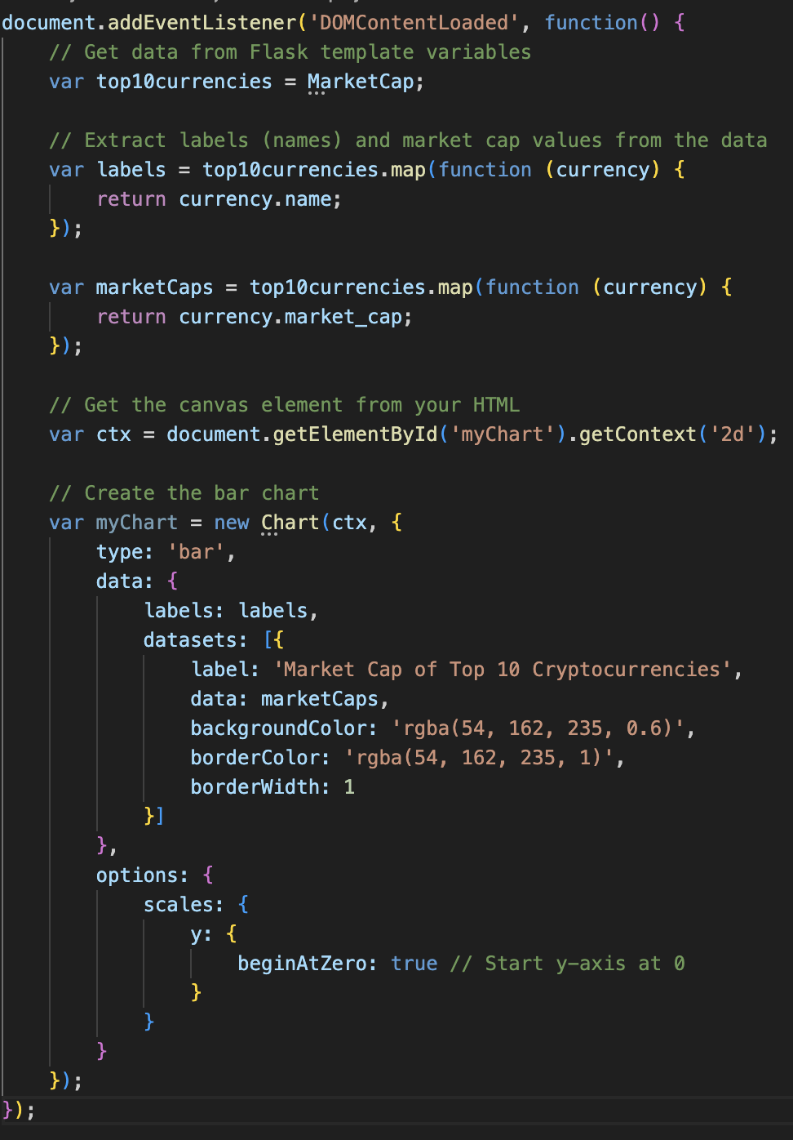
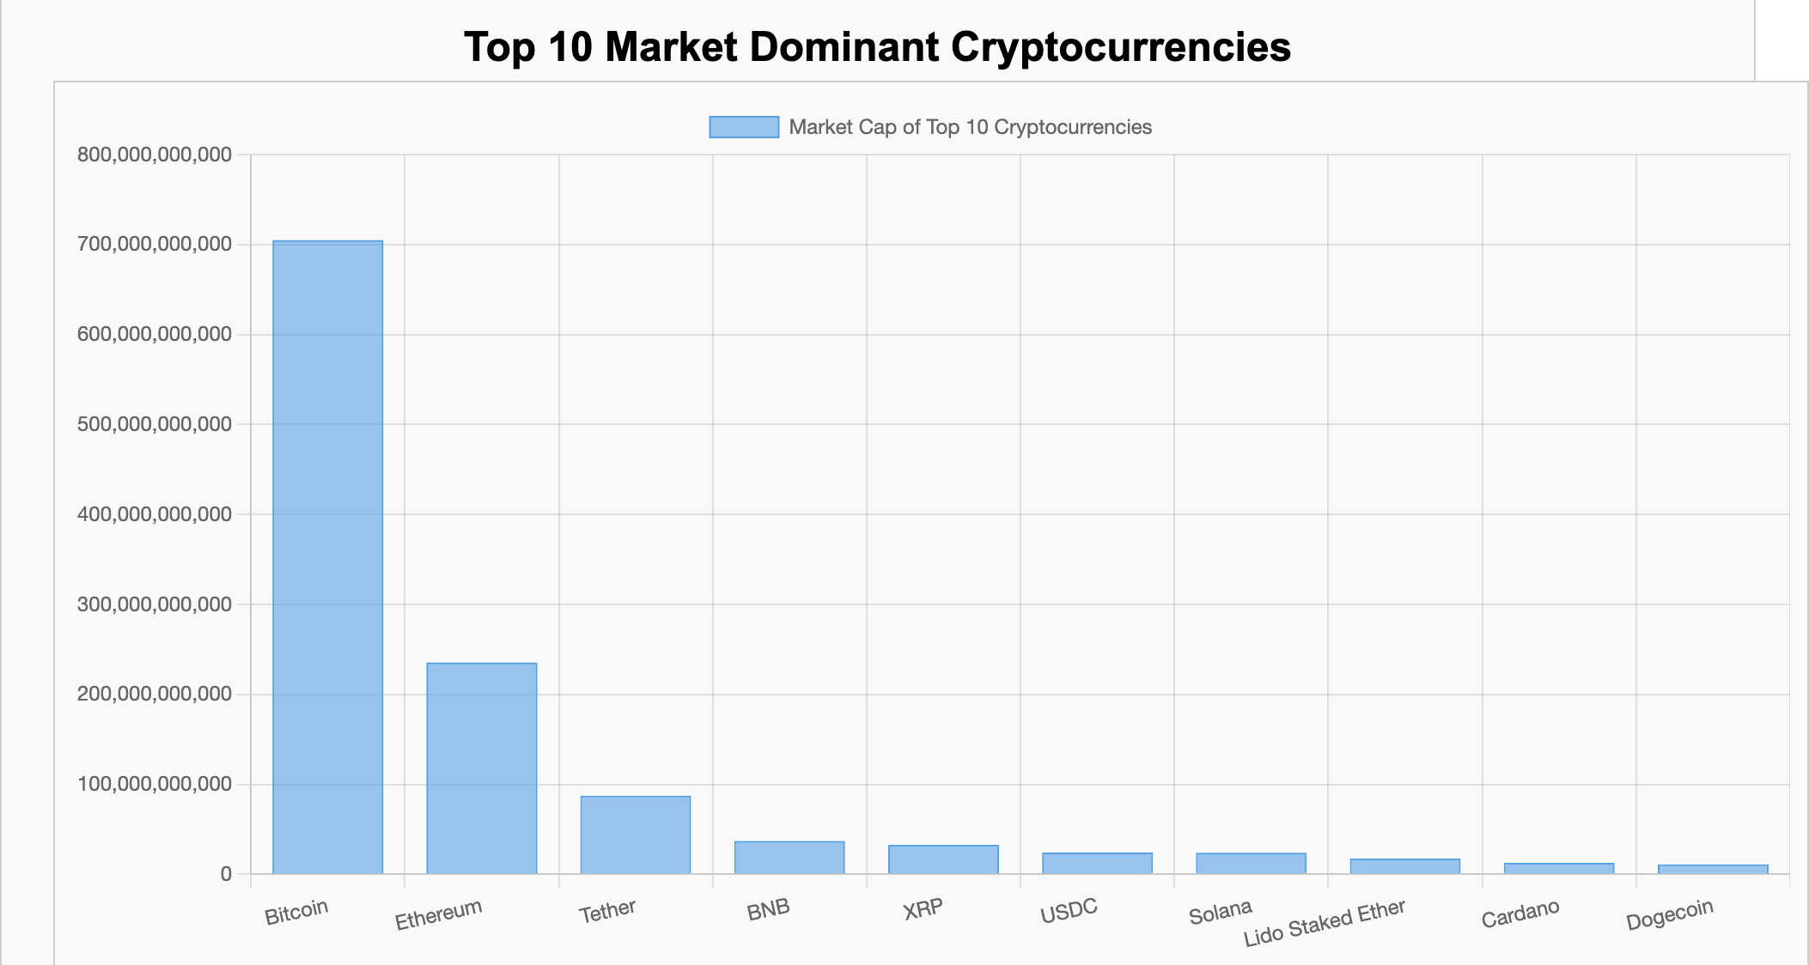
Market Dominance of the top 10 Cryptocurrencies

Slide 7
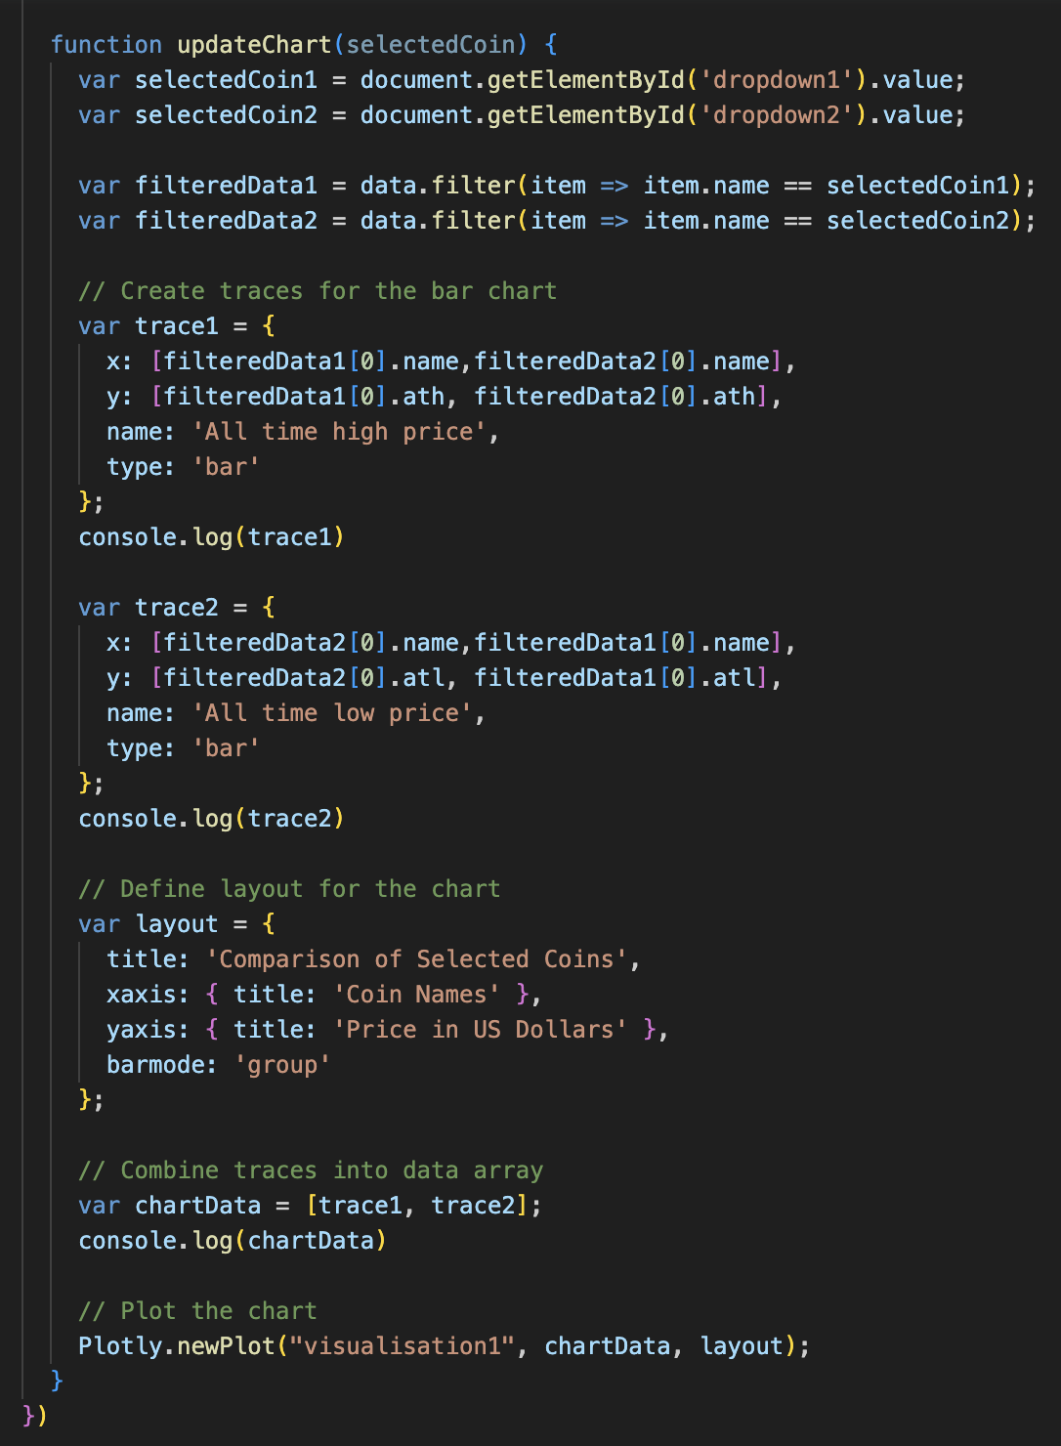
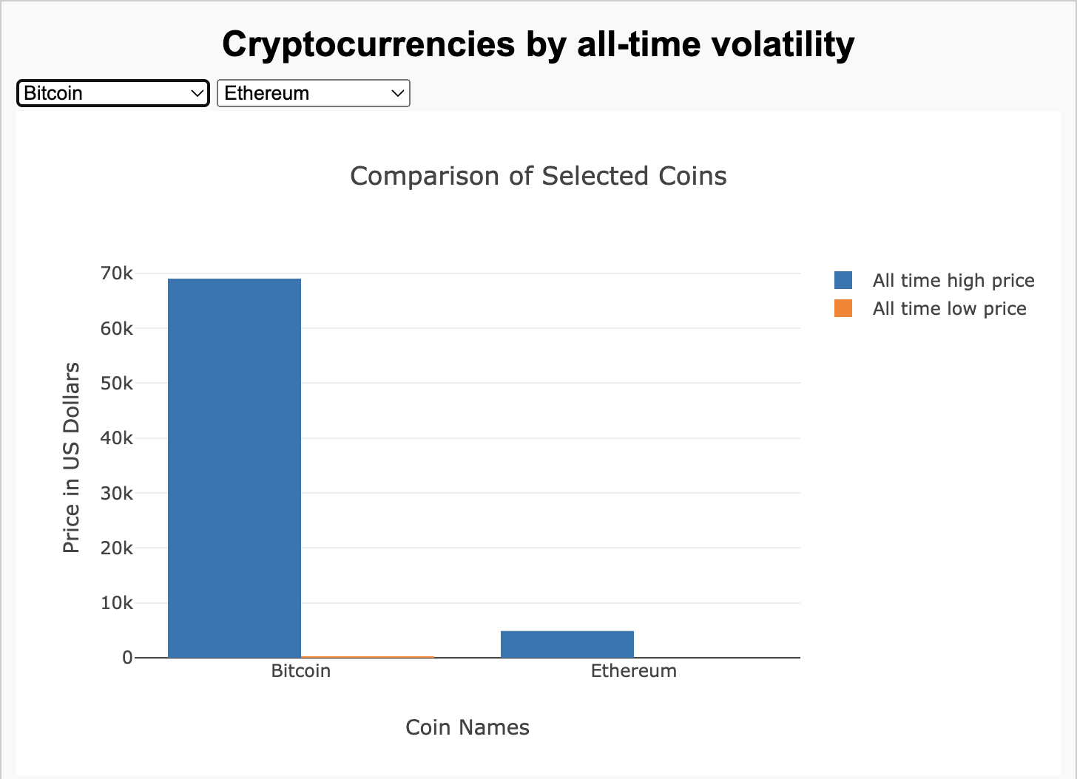
Cryptocurrencies by all-time volatility

Slide 8
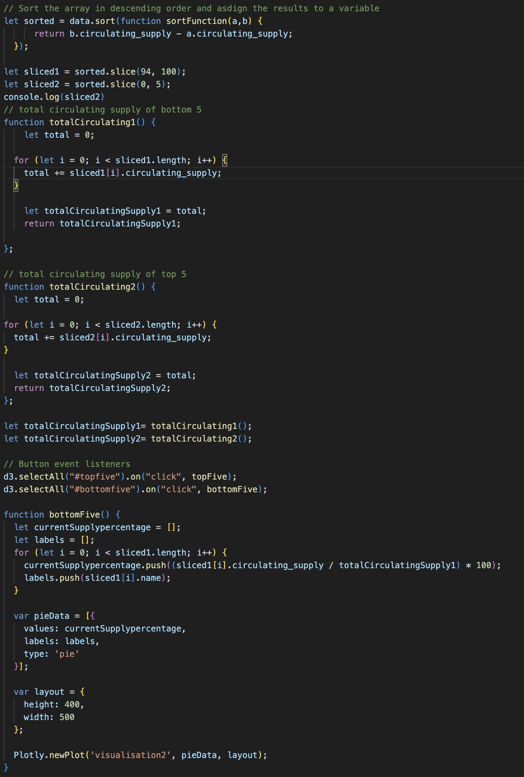
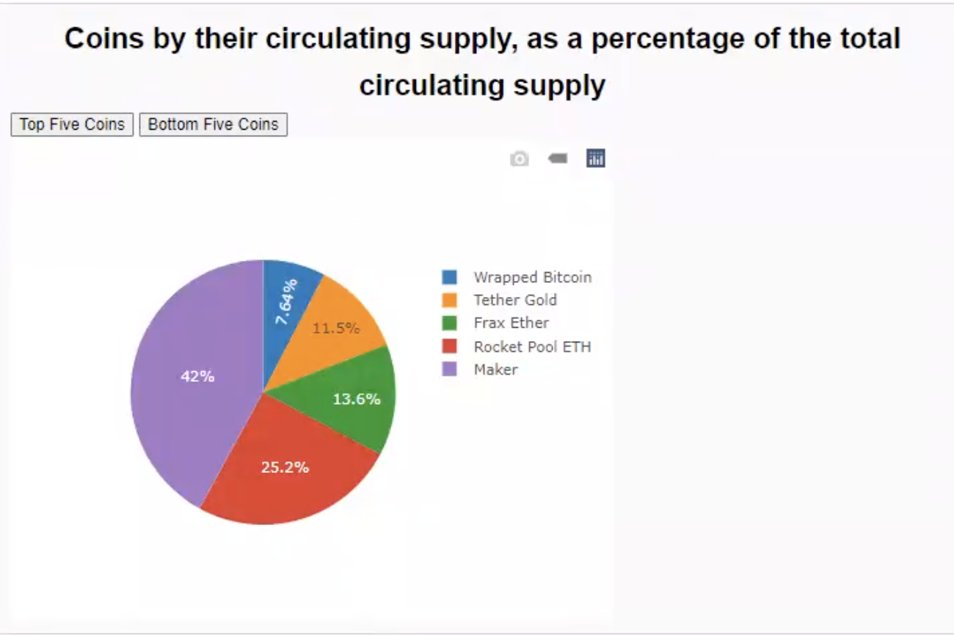
Coins by their circulating supply, as a percentage of the total circulating supply

Slide 9
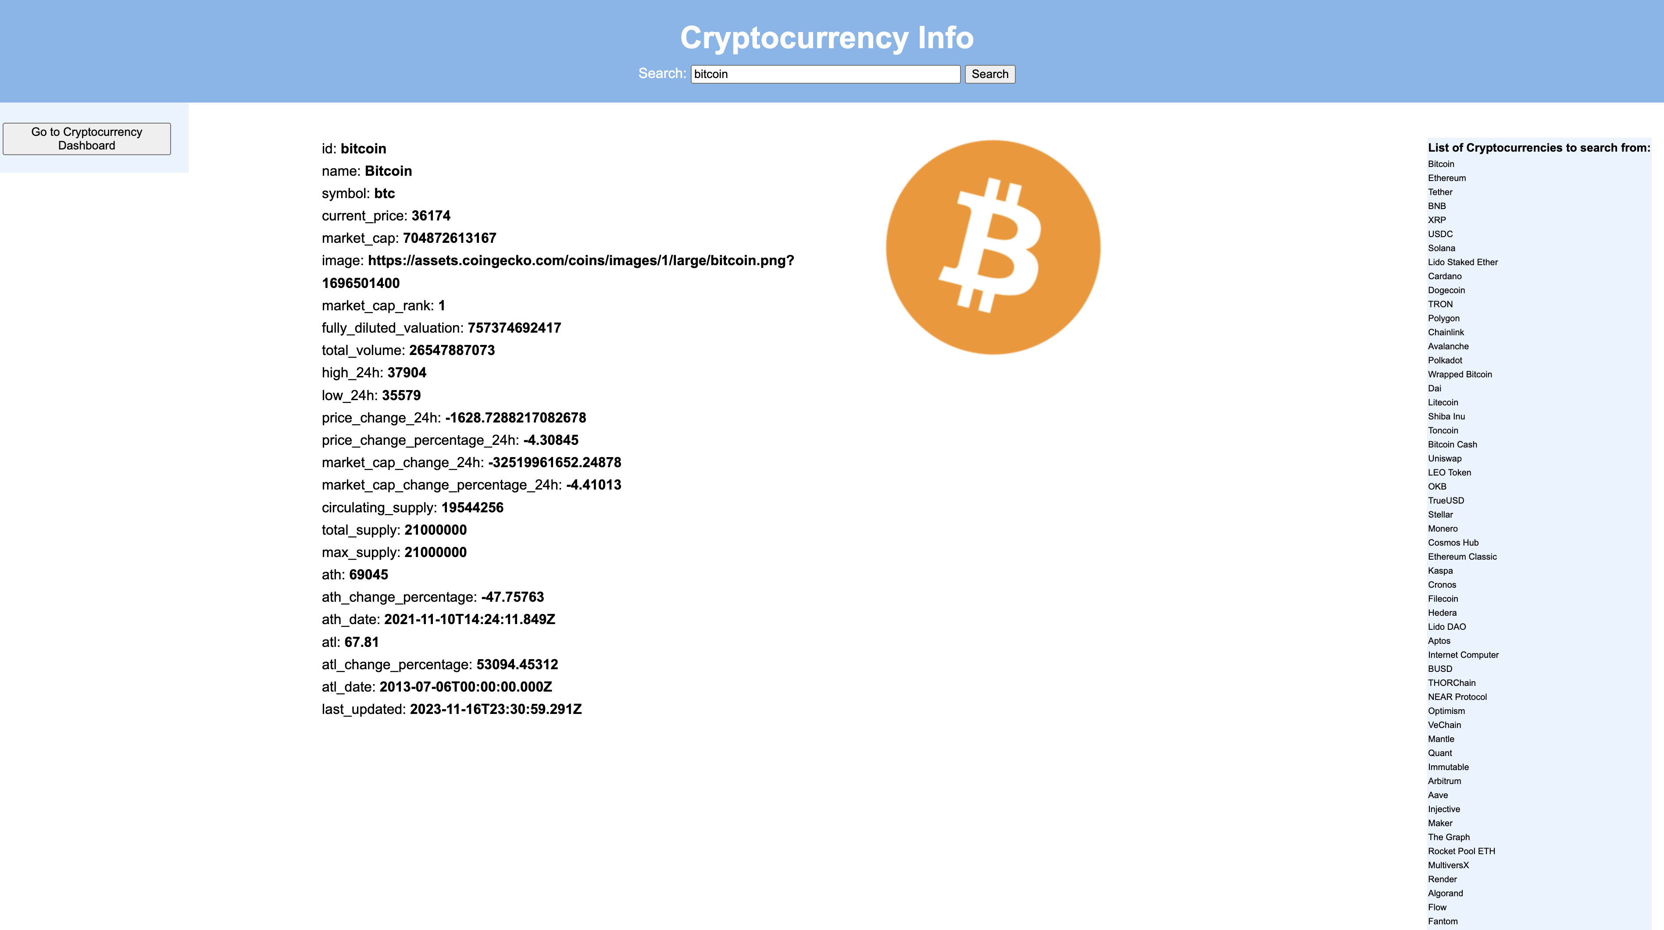
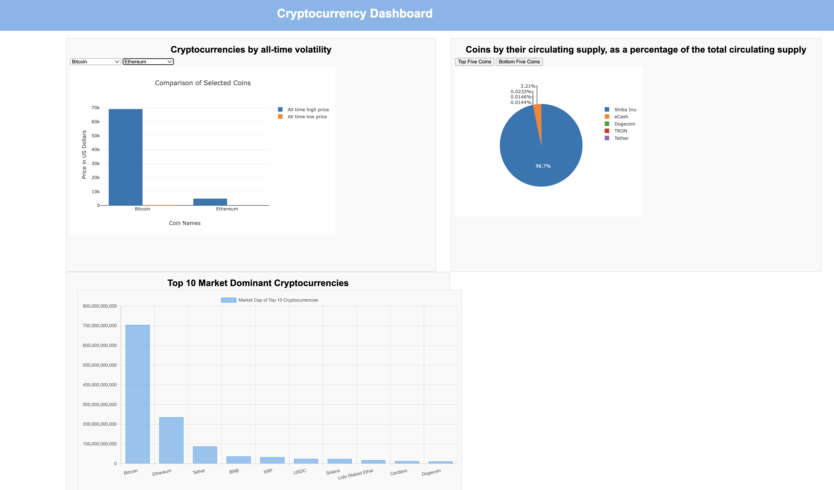
Our Web app

Slide 10
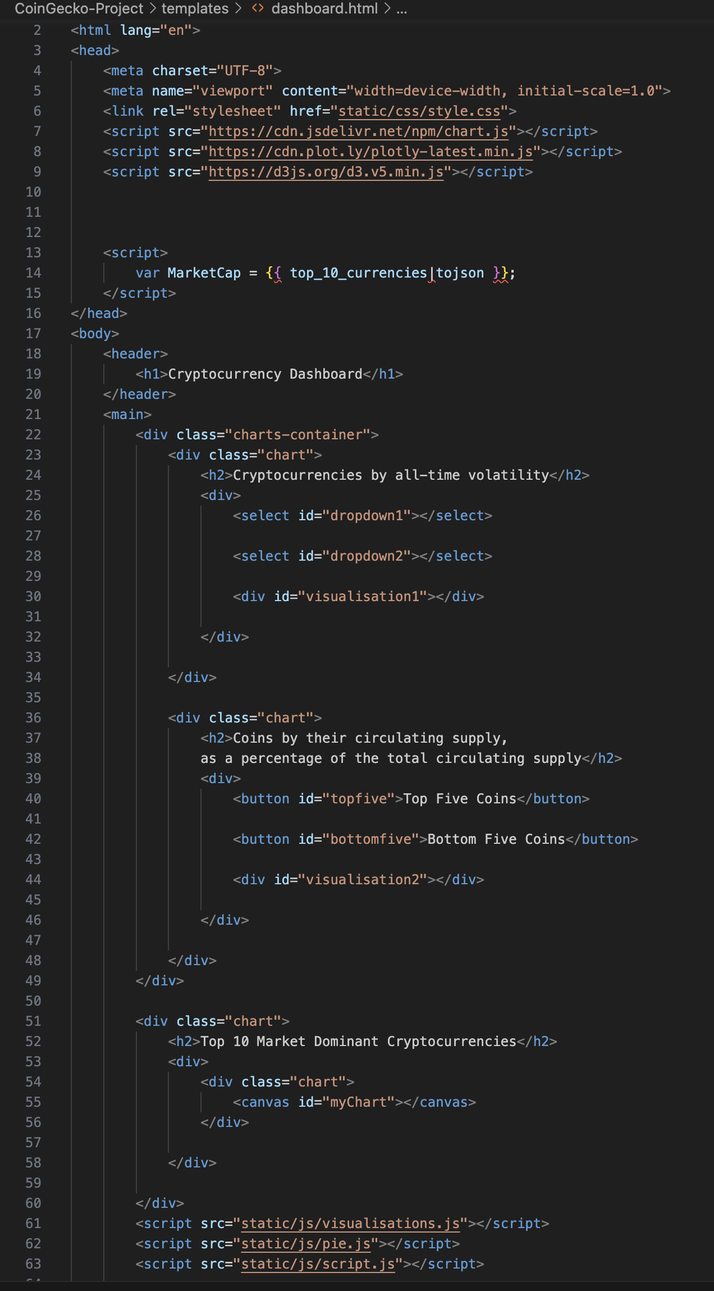

HTML
We incorporated the HTML to include all of our
JavaScript files, to create and structure the content of the webpages, allowing browsers to render and display information in a structured and accessible manner

Slide 11
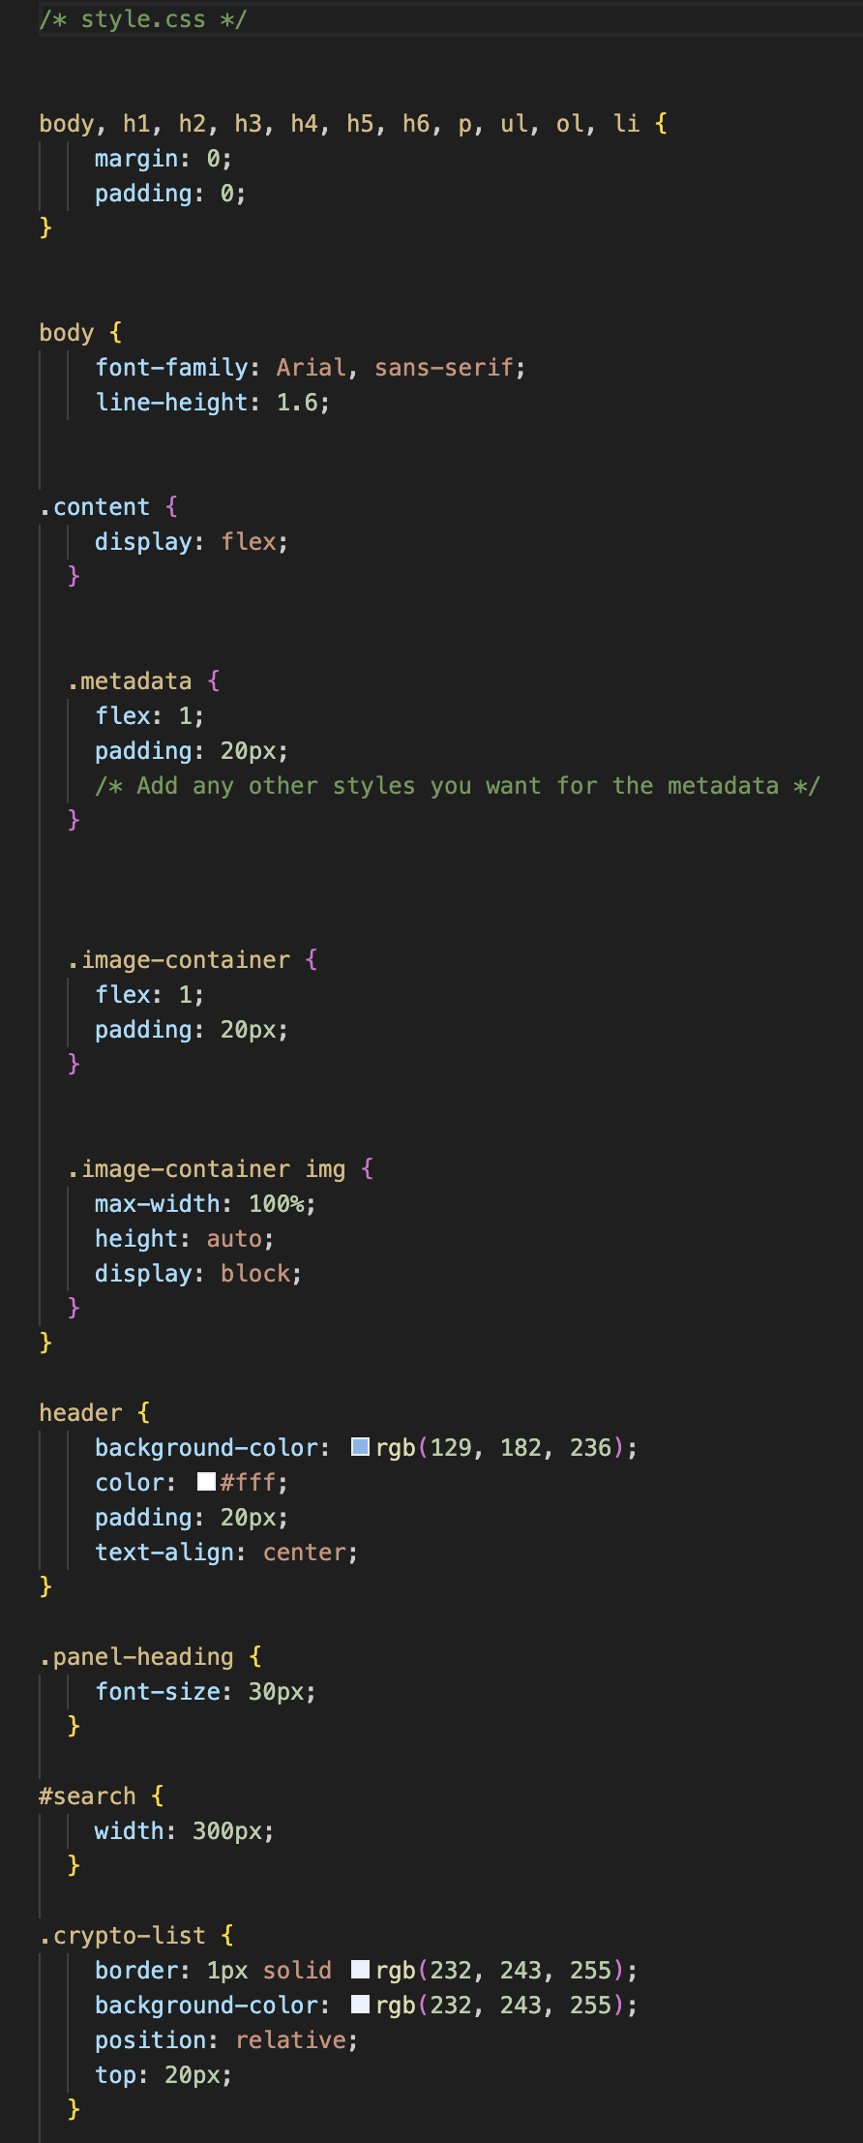

CSS
We incorporated CSS to control the visual presentation and layout of the web pages, ensuring a cohesive and attractive user experience across different devices and browsers.

Slide 12


